Slide 1
“BMMOA Maritime Excellence Award”
Is to recognize individual merchant mariner’s with sustained superior performances and contributions to merchant marine profession & fraternity.

Slide 2
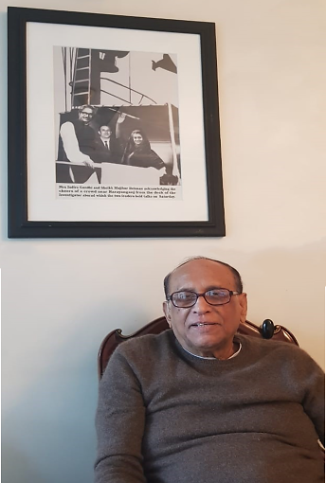
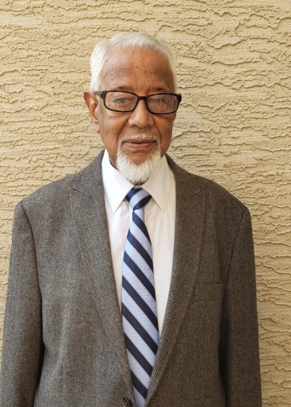
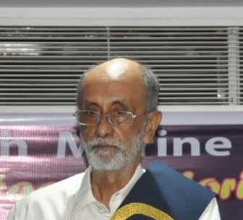
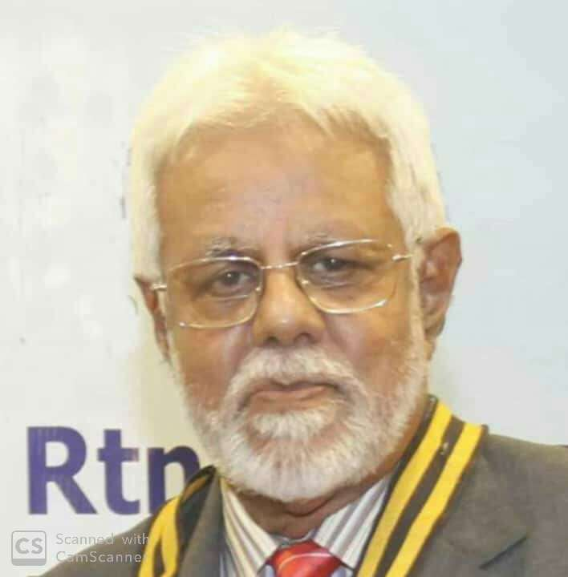
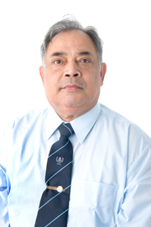
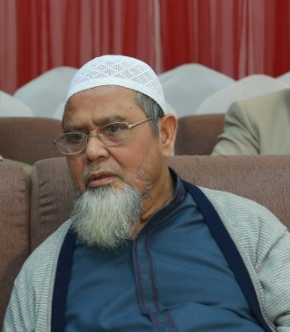
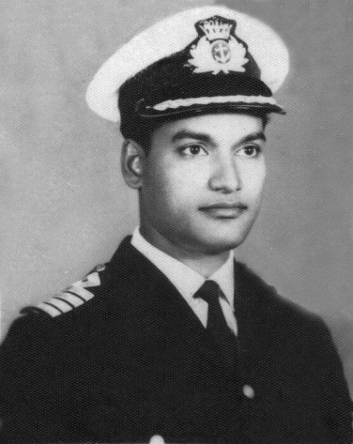
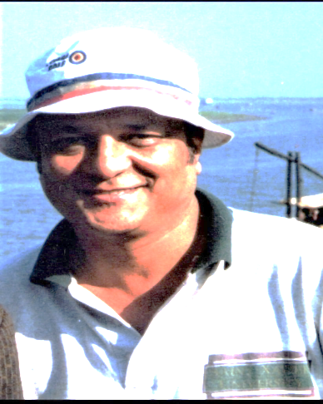
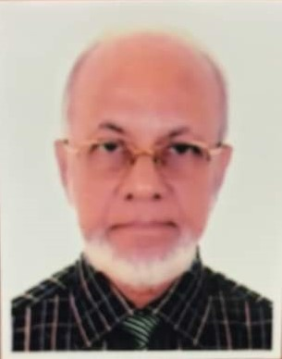
Capt. Q.A.B.M. Rahman
Capt. Mohammad Shafi
Engr. Zahedur Rahman
Engr. Md. Ainul Haque
Engr. Zakaria Khan Majlis
Capt. Fazlur Rahman Chowdhury
Engr. Nurul Wahab Khandakar
Late Capt. M.L. Rahman
Late Engineer FaruqTawfiqur Rahman
Capt. Md. Zakaria

Slide 3
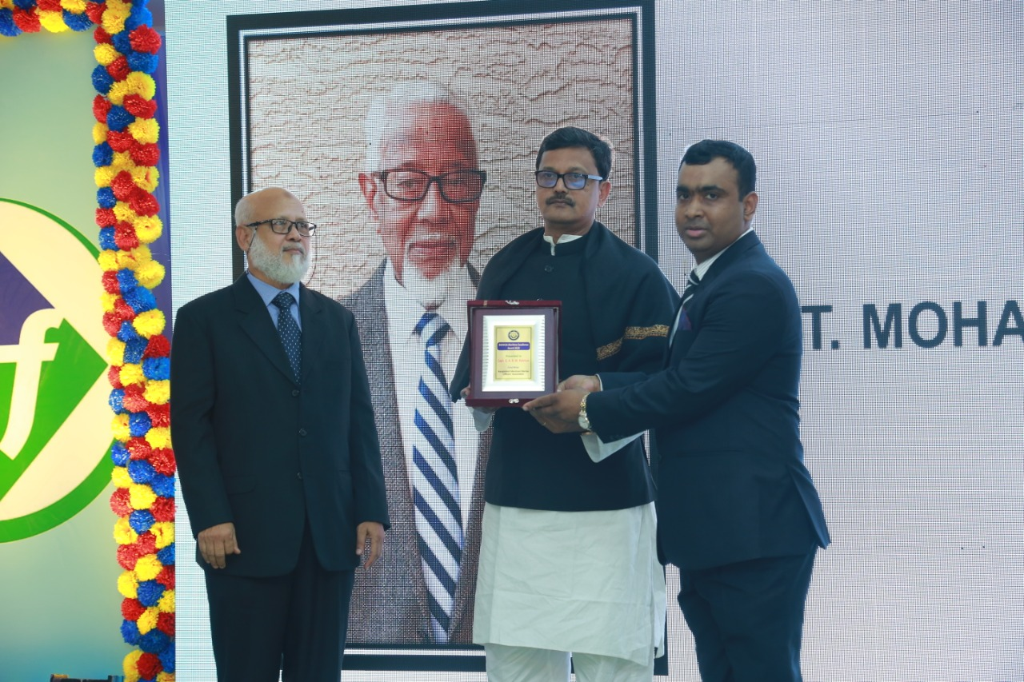
Capt. Q.A.B.M. Rahman
Engr .Md. Golam Zilani
is receiving the award
on behalf of Capt. Q.A.B.M Rahman
from
Mr. Khalid Mahmud Chowdhury, MP
Honorable State Minister
Ministry of Shipping.
Bangladesh Merchant Marine Officers’ Association

Slide 4
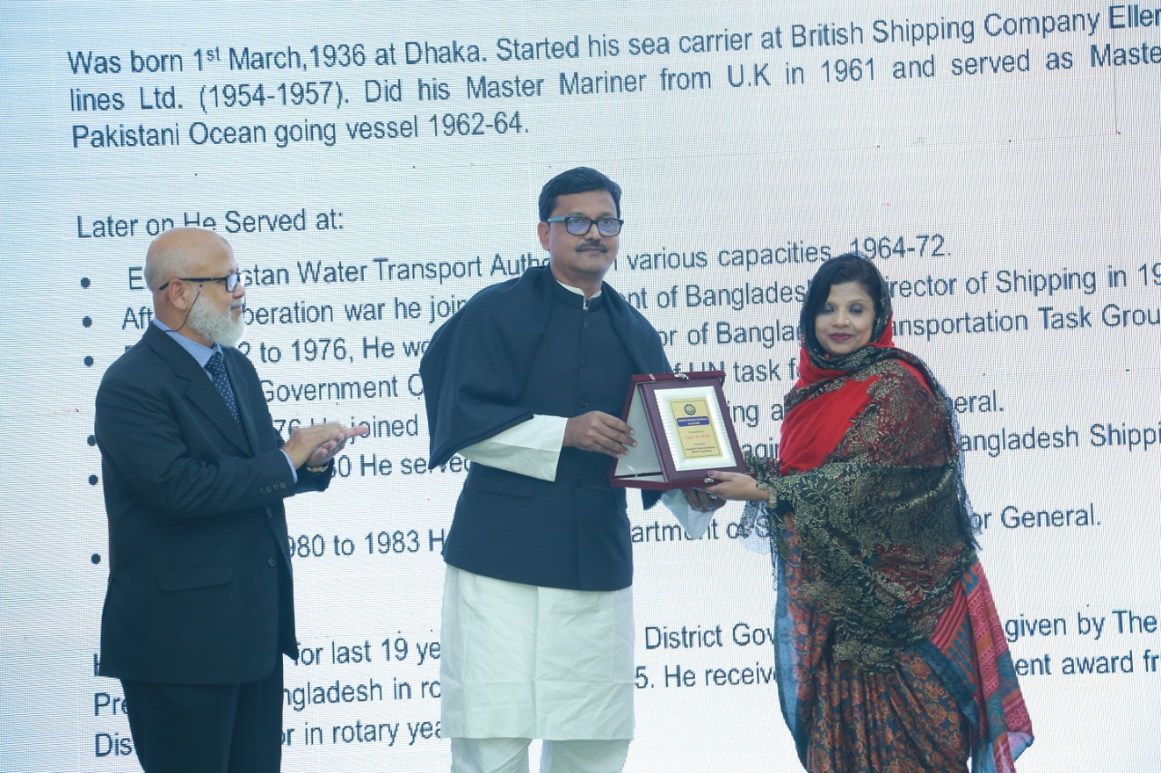
Capt. Mohammad Shafi
Sabera Khanom Shafi
(Daughter of Capt. M. Shafi)
is receiving the award
on behalf of Capt. M. Shafi from
Mr. Khalid Mahmud Chowdhury, MP
Honorable State Minister
Ministry of Shipping.
Bangladesh Merchant Marine Officers’ Association

Slide 5
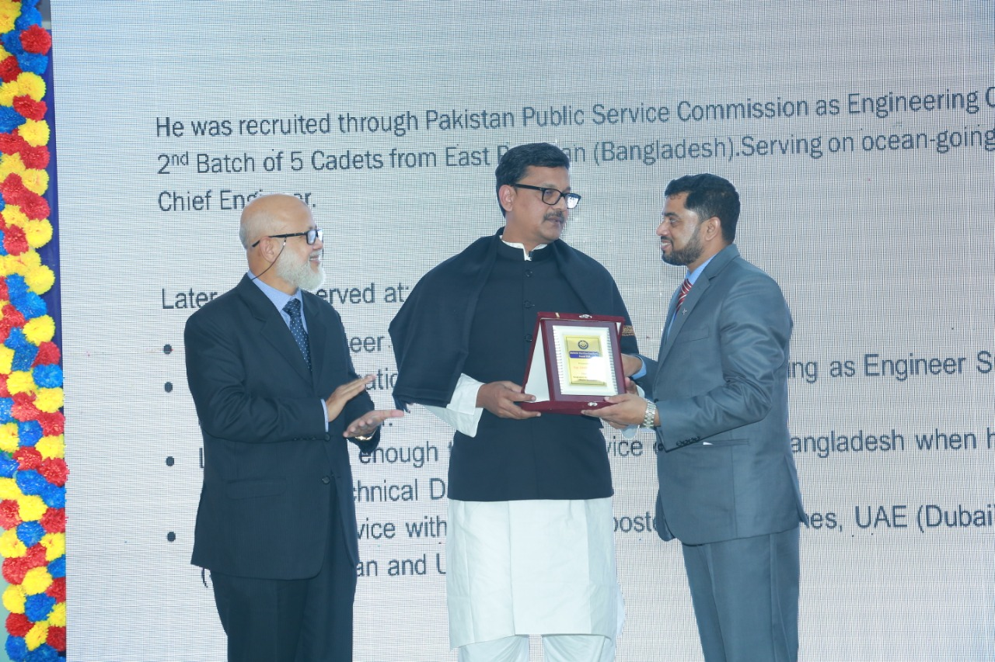
Engr. Zahedur Rahman
Capt. Ranakul Islam
is receiving the award on behalf of
MarEngr. Zahedur Rahman
CEngr. FIMarEST from
Mr. Khalid Mahmud Chowdhury, MP
Honorable State Minister
Ministry of Shipping.
Bangladesh Merchant Marine Officers’ Association

Slide 6
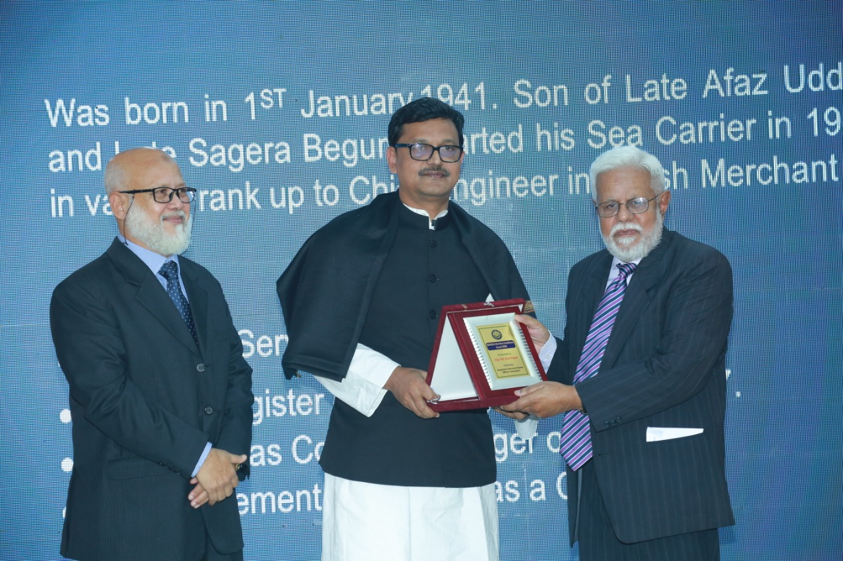
Engr. Md. Ainul Haque
Engr. Md. Ainul Haque
is receiving the award from
Mr. Khalid Mahmud Chowdhury, MP
Honorable State Minister
Ministry of Shipping.
Bangladesh Merchant Marine Officers’ Association

Slide 7
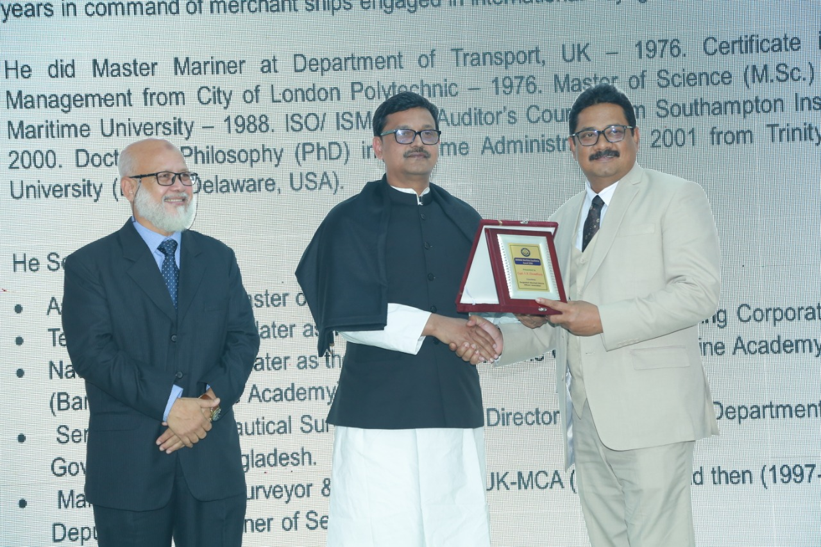
Capt. Fazlur Rahman Chowdhury
Engr. Md. Abdul Mobin
(Nephew of Capt. Fazlur Rahman Chowdhury)
is receiving the award
On behalf of Capt. F. R. Chowdhury from
Mr. Khalid Mahmud Chowdhury, MP
Honorable State Minister
Ministry of Shipping.
Bangladesh Merchant Marine Officers’ Association

Slide 8
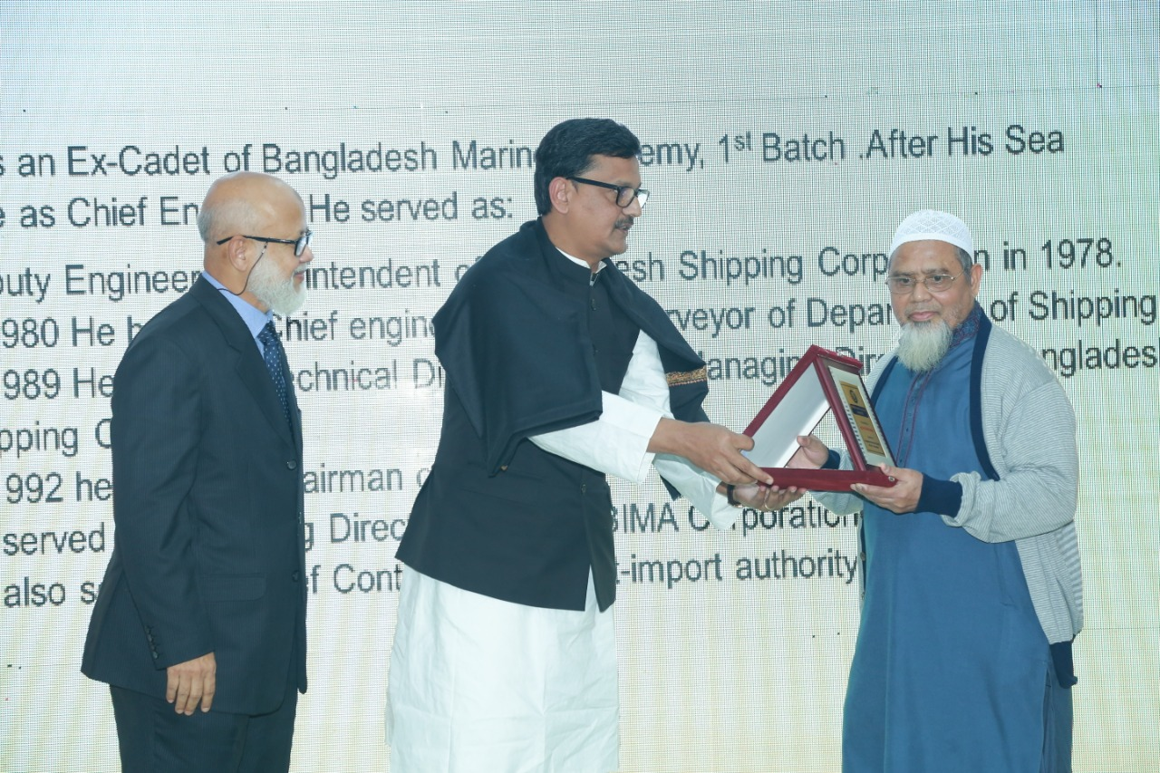
Engr. Nurul Wahab Khandakar
Engr. Nurul Wahab Khandakar
is receiving the award from
Mr. Khalid Mahmud Chowdhury, MP
Honorable State Minister
Ministry of Shipping.
Bangladesh Merchant Marine Officers’ Association

Slide 9
Engr. Zakaria Khan Majlis
Engr. Md Ainul Haque
is receiving the award
on behalf of
Engr. Zakaria Khan Majlis from
Mr. Khalid Mahmud Chowdhury, MP
Honorable State Minister
Ministry of Shipping.
Bangladesh Merchant Marine Officers’ Association

Slide 10
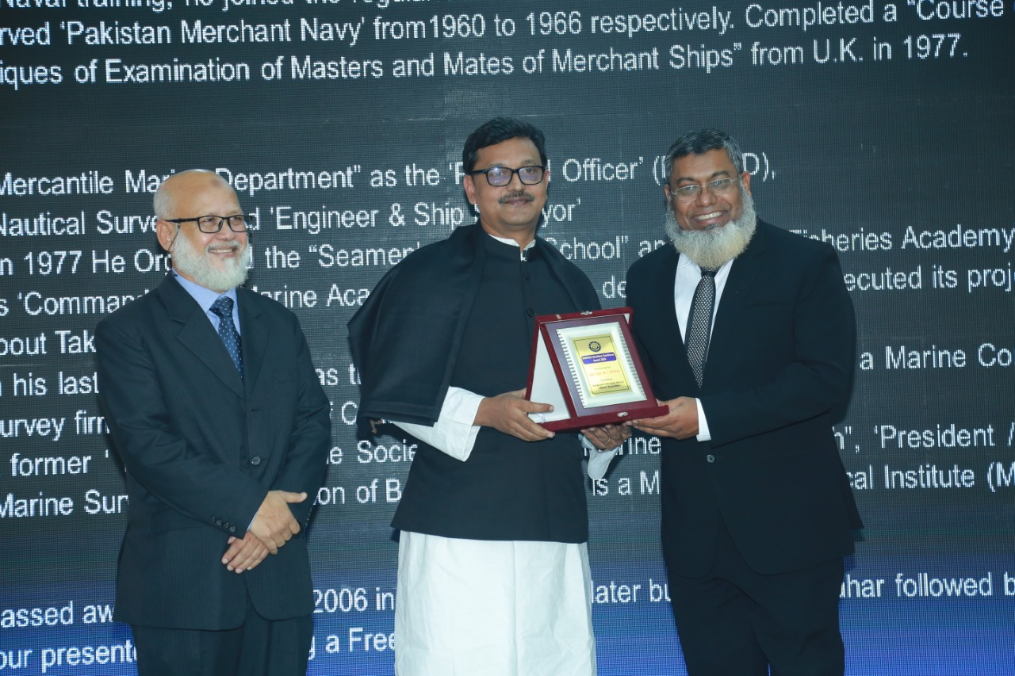
Late Capt. M.L. Rahman
Capt. Mujibur Rahman
(Son of Late Captain M.L. Rahman)
is receiving the award
on behalf of Late Capt. M.L. Rahman from
Mr. Khalid Mahmud Chowdhury, MP
Honorable State Minister
Ministry of Shipping.
Bangladesh Merchant Marine Officers’ Association

Slide 11
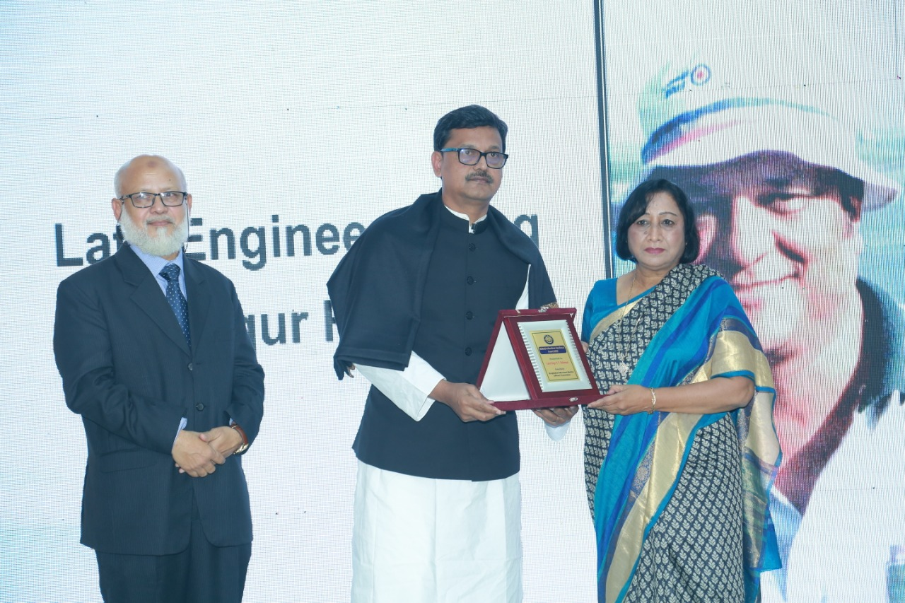
Late Engineer Faruq Tawfiqur Rahman
Late Engr. Faruq Tawfiqur Rahman’s Wife
is receiving the award
on behalf of Late Engr. F.T. Rahman from
Mr. Khalid Mahmud Chowdhry, MP
Honorable State Minister
Ministry of Shipping.
Bangladesh Merchant Marine Officers’ Association

Slide 12
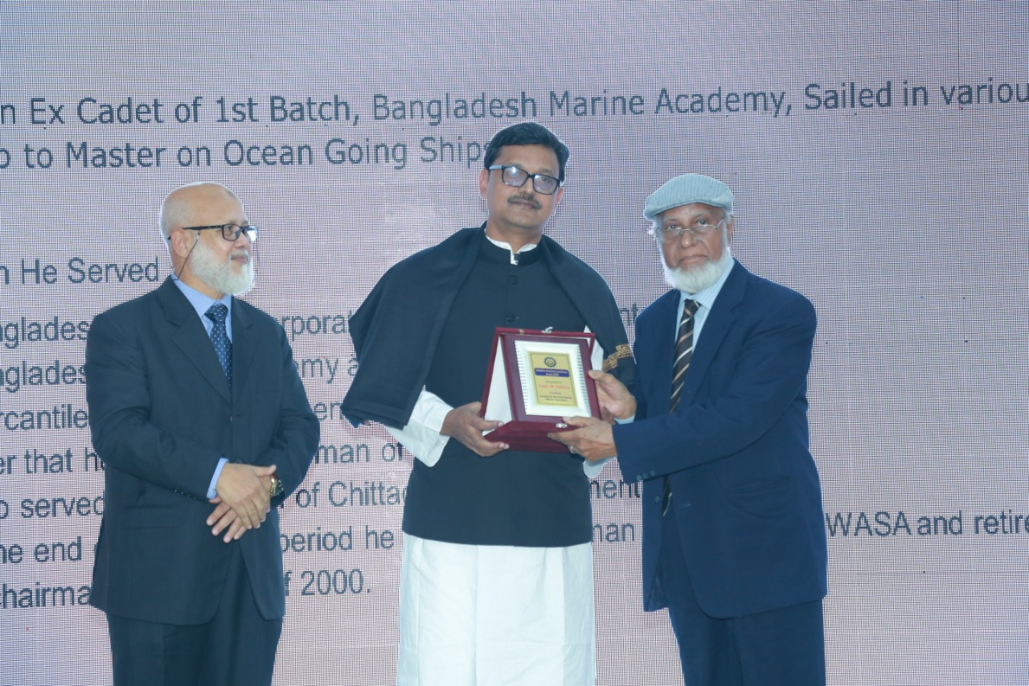
Capt. Md. Zakaria
Capt.Md Zakaria
is receiving the award from
Mr. Khalid Mahmud Chowdhury, MP
Honorable State Minister
Ministry of Shipping.
Bangladesh Merchant Marine Officers’ Association

Slide 13
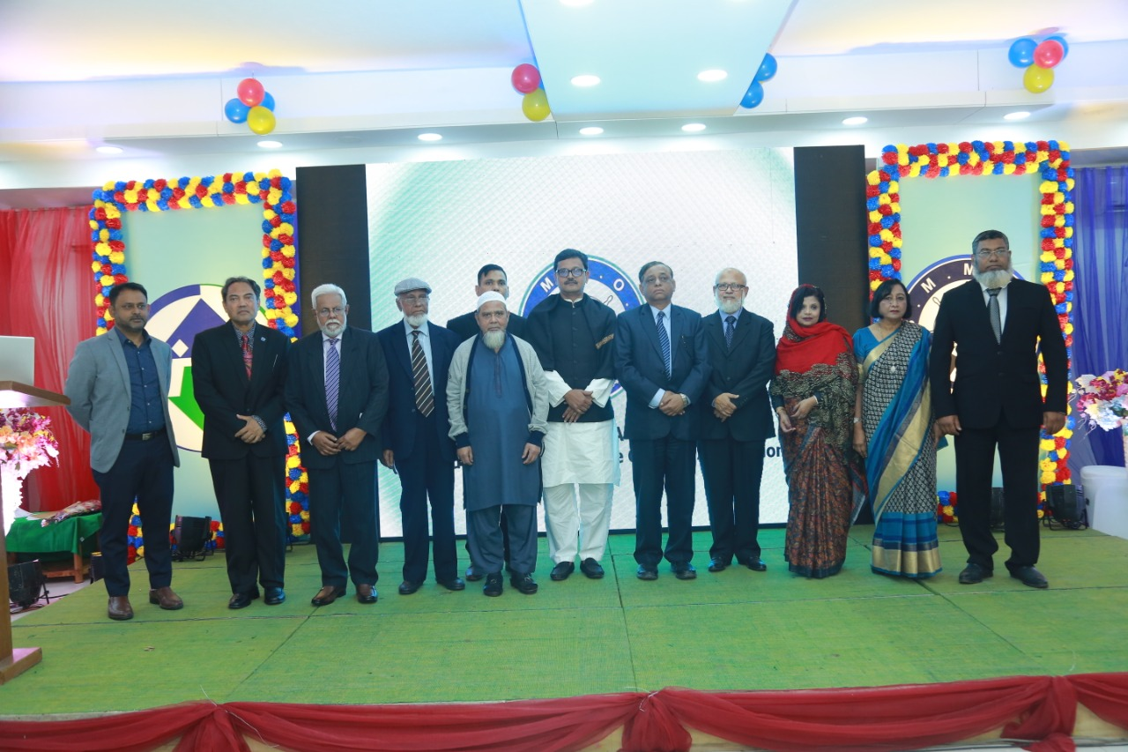
Respected award receiver
and their nominees are with
Mr. Khalid Mahmud Chowdhury, MP
Honorable State Minister
Ministry of Shipping.
Bangladesh Merchant Marine Officers’ Association

Slide 14
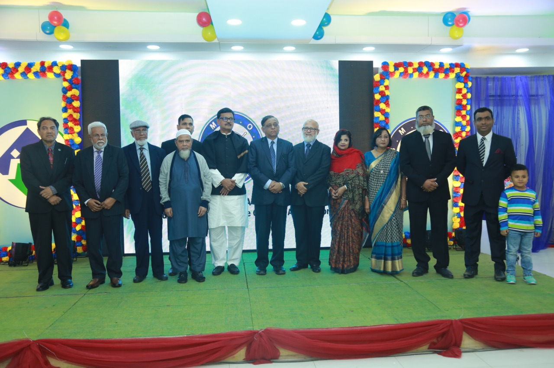
Respected award receiver
and their nominees are with
Mr. Khalid Mahmud Chowdhury, MP
Honorable State Minister
Ministry of Shipping.
Bangladesh Merchant Marine Officers’ Association

Slide 15
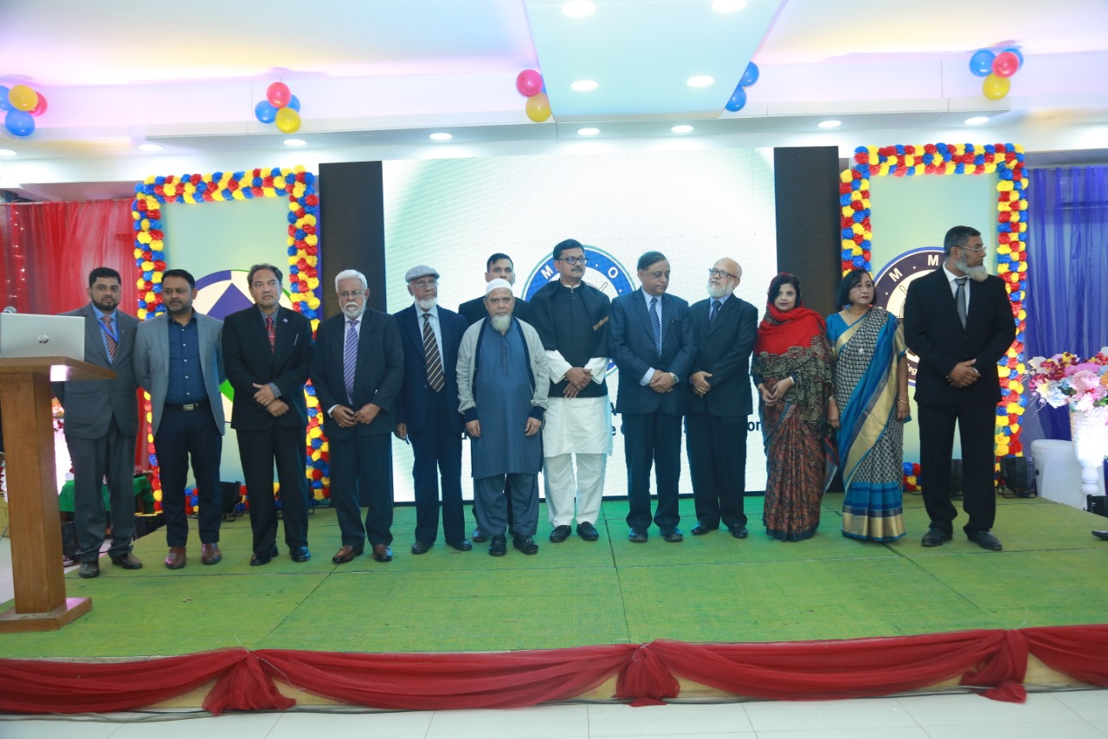
Respected award receiver
and their nominees are with
Mr. Khalid Mahmud Chowdhury, MP
Honorable State Minister
Ministry of Shipping.
Bangladesh Merchant Marine Officers’ Association

Slide 16
Bangladesh Merchant Marine Officers’ Association
No Person was ever honored for
what he received.
Honor has been the reward for
what he gave.
Calvin Collidge
Thank you

